Slide 1
Forensic Biology & serology
Nature & importance of biological evidence
Collection and preservation of biological evidences

Slide 2
Forensic Biology
Forensic biology is a branch of forensic science which deals with biological evidences and their examination for the administration of justice in the court of the law.
Biological evidences consists of body fluid and tissues.
Biological evidence is a type of physical evidences which contains DNA.
The biological evidences are-
Blood
Semen
Saliva
Urine
sweat
Faecal matter
Milk
Hair

Slide 3
Crimes in which biological evidences may be important
Murder
Rape
Robbery
Paternity
Mass fatality incidents
Sexual Assault
Motor vehicle incident etc.

Slide 4
Importance of biological evidences.
Every crime takes place at a certain time at a certain places and it involves victim and perpetrator.
Biological material or evidences is important evidence found at almost every crime scenes involving a physical violence.
It play an important role in the crime investigation.
It link a victim to a suspect and a suspect to a crime scene.
It helps in narrowing down the accused.
Blood traces can help in determining the identity of an individual by the process of DNA typing from blood.

Slide 5
In blood pattern is present on crime scene-
The direction from which blood originated.
The angle at which a blood droplet struck a surface.
The location or position of a victim at the time a bloody wound was inflicted.
The movement of a bleeding individual at the crime scene.
The minimum number of blows that struck a bleeding victim.
The approximate location of an individual delivering blows that produced a bloodstain pattern.
Nature
Blood- it is connective fluid tissue, red in colour.
Semen- It is white, yellowish starchy fluid of the body.
Saliva- white, frothy and concentrated fluid contain a mixture of the antigen and enzymes.
Vomit- it is yellow, green, black coloured liquid containing undigested or partially digested food matter.
Urine- is a transparent yellowish liquid which is excreted by urethra.

Slide 6
COLLECTION OF BIOLOGICAL EVIDENCES
After the crime scene documentation is completed, the collection of evidence can be initiated.
For blood and semen stain, gauze piece or plain , wool swab must be used.
Samples should be dried before packing otherwise these will get decomposed.
If dried semen or blood stain is suspected on clothing, body, or pubic hair cotton swabs moistened saline can be used.
Pubic Hair combing samples can be retained for comparison with suspected hair found with suspects.
Nail clipping or scraping can be preserved for analysis and comparison.
Bite mark swab for DNA profiling.

Slide 7
Biological evidence and materials should be collected in a manner that prevents contamination and degradation and ensures integrity during all phases of the investigation and litigation.
To avoid contamination, sample collection tools and materials must be free from human DNA.
Disposable latex examination gloves, individually wrapped swabs or other individually wrapped items are free of human DNA.
Ways to prevent contamination and degradation of biological evidence:
Use disposable latex (or similar) gloves to handle evidence rather than reusable uniform/tactical gloves. Do not touch the outside of gloves to face or hands, or use personal items such as cell phones or radios and change gloves after contact with potential biological evidence.
When field testing evidence, swab the stain and test the swab rather than directly testing the stain. If the stain is small, it should be tested in a lab rather than in the field.
Fingerprint powder and brushes carry biological material from one item to the next. Collect DNA samples before powdering or use single use brushes and sterile powder.

Slide 8
4. Wet items may be dried by hanging or by laying out on a clean surface indoors away from the scene.
5. Package each item separately.
6. The use of personal protective equipment (disposable clothing, gloves, masks, etc.) both protects the individual from biohazard exposure and prevents transfer of the investigator’s DNA to the evidence.

Slide 9
Bloodstain pattern evidence: It is especially important to thoroughly document the bloodstain pattern evidence at a crime scene prior to collection. Bloodstain patterns can be especially useful in crime scene reconstruction.
Trace evidence: Trace evidence such as hairs and fibers can be present in bloodstained evidence and should be identified and properly collected.
Control samples: Control (known or blank) samples should be collected from a control area (e.g., unstained area near a Collected stain).
Wet evidence: Wet evidence should be air-dried (without heat) prior to packaging to prevent the degradation of proteins and nucleic acids, which are used for forensic serological and DNA analysis.

Slide 10
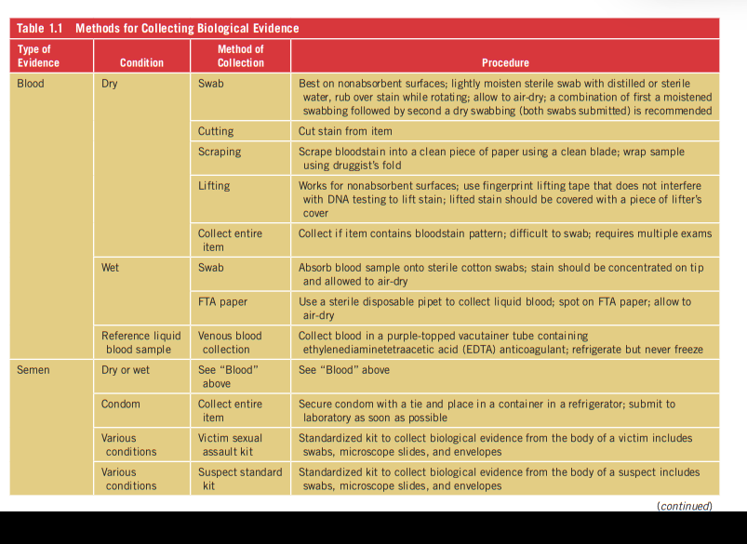

Slide 11
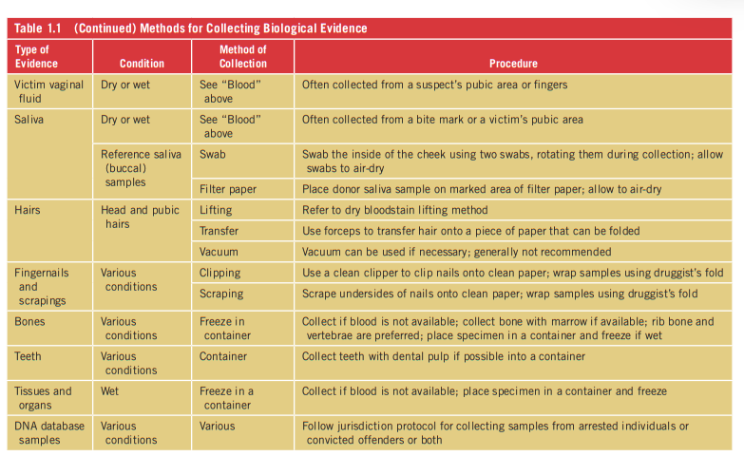

Slide 12
Various packaging methods are-
Evidence from different sources: To prevent the transfer of evidence from different sources, items of evidence should not be grouped in a single package. However, evidence may be packed in a single container if the items were found together.
Folding of evidence: Folding of clothing, especially items with wet bloodstains, can transfer evidence from one part of a garment to another. If a large, dry garment must be folded, a piece of clean paper should be placed between different parts of the garment to avoid direct contact between the different parts of the garment, thereby preventing the transfer of evidence.
Packing materials: Envelopes, bags, and boxes that are made of porous materials such as paper are appropriate for packaging dry biological evidence. Dry, bloodstained evidence should not be sealed in plastic bags or containers that trap moisture.
Liquid evidence: Tubes containing liquid such as blood should not be frozen because the volume of a liquid expands in freezing temperatures and this expansion may lead to cracking. Tubes should be placed in plastic bags to prevent leaks in case of accidental breakage.
Trace evidence: All such evidence should be wrapped in paper with a druggist’s fold .The wrapped trace evidence can be packed in an envelope.

Slide 13
keep in mind when packaging biological evidence at a crime scene
Package evidence and seal the container to protect it from loss, cross transfer, contamination and/or deleterious change.
Seal the package in such a manner that opening it causes obvious damage or alteration to the container or its seal.
Package evidence for safety by using boxes or breathable tubes for sharp items, marking items and informing the laboratory if a biohazard is present.
Package unloaded firearms in clean, unused boxes when submitting them for biological analysis. Mark the packaging and inform the laboratory if a biohazard is present.
Use paper bags, envelopes, boxes and similar materials for all biological evidence.
Avoid plastic packaging as an inner or outer package.
Avoid the use of pill tins due to possible rust.

Slide 14
Ensure that all swabs and evidence are dry.
Package each item separately; avoid commingling items to prevent cross contamination.
Swabs collected from a single item may be packaged in the same container.
Mark each package with a detailed description that includes the item, location where it was collected, name of the person who collected it and date of collection.
Seal each package with tape. (staples are not considered a proper seal.) All seals must be marked to identify the person making the seal. Mark through the seal with name or initials and date.
The integrity of the item often is maintained through the package’s documentation. That documentation includes all markings, seals, tags and labels used by all of the involved agencies. Therefore, it is critical to preserve or document all packaging and labels received by or returned to your agency.

Slide 15
Preservation
In case of blood
Peripheral vein blood( femoral, sub-clavian) is preferred.
Blood is syringed out or can be taken after opening the veins.
Sample should be kept in a screw cap bottle containing sodium Fluoride and potassium oxalate.
100 mg of NaF and 30 mg of Potassium Oxalate to 10ml of blood should be added.
In case of urine
Supra pubic puncture samples can be collected from urinary bladder.
100mg sodium fluoride for every 10 ml of urine is recommended.

Slide 16
These samples are properly collected and preserved and send for analysis.
The preserved samples is labelled with place of crime, time of crime, collecting time, date, investigator name and seal of departmental seal for maintaining the chain of custody.

